Slide 1
POULTRY SCIENCE: Environmental Management
Unit 15

Slide 2
Poultry Science: Environmental Management
Unit 15: Segment 1
Environmental Management Practices

Slide 3
Poultry Processing Wastewater (PPW)
PPW – the cumulative wastewater that is generated by uncollected blood, feathers, eviscerations, and cleaning of the live haul area at a poultry processing plant.
Largest consumers of water include evisceration, chilling, and clean-up.
A typical broiler processing facility utilizes 6-9 gallons of water per bird each process day to produce a wholesome sanitary dressed poultry product. This could mean 1-1.5 million gallons of wastewater is produced per day!
So what happens to it all? Is it wasted?

Slide 4
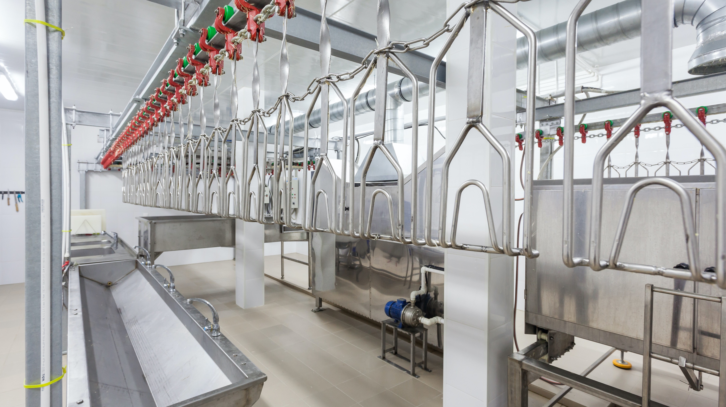
Poultry Processing Wastewater (PPW)
This water will be laden with fats, proteins and carbohydrates from meat, blood, skin, and feathers as well as a fair amount of grit and other inorganic matter.
Poultry processing plants are required to remove the majority of all soluble and particulate organic material in their generated wastewater prior to any discharge from the plant in order to remain in compliance with local, state, and federal environmental regulations.
Once it goes through the entire treatment process, it is ?????

Slide 5
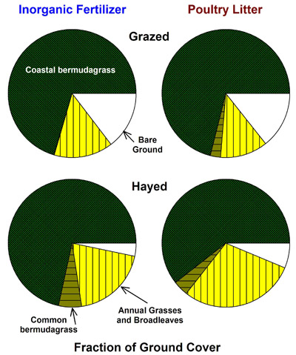
Poultry Litter
Litter is poultry excrement that is left behind in the poultry house
Incredible natural fertilizer that is commonly used on pastures and hayfields (particularly in North Georgia) with primary, secondary, and micronutrients when used properly
Typical fertilizer equivalent = 3-2-2 BUT nutrient content depends on the following factors:
Type of bird
What the birds are fed
Number of grow-out cycles before house is cleaned out
Feed efficiency of bird(s)
How the litter is stored and handled
Fraction of ground cover in coastal bermudagrass, common bermudagrass, annual grasses/broadleaf weeds, and bare ground after five years fertilization with ammonium-nitrate fertilizer (200 lbs N/ac/yr) or poultry litter (173 total N/ac/yr in two applications).

Slide 6
Poultry Litter: N-P-K
Nitrogen (N)
Mostly in organic form (about 89%), but ammonium and a small amount of nitrate are also present (ammonium and nitrate = inorganic form of nitrogen)
Organic nitrogen is not available to the plants until it is converted to ammonium or nitrate by microorganisms in the soil
The rate of this conversion depends on soil moisture and temperature, with favorable conditions being moist and warm (above 50ºF)

Slide 7
Poultry Litter: N-P-K
Phosphorus (P)
Good source of phosphorus, which is beneficial for grasses, etc. but can cause environmental problems if the soil is already high in phosphorus as it is available to the plants when applied
Phosphorus buildup is slower in hayfields where hay is being removed than it is in pastures where it is already being returned to the soil via manure and urine
High phosphorus levels in the soil have been directly linked to water quality problems, so it is vital that poultry litter is utilized properly after nutrient needs of the forage are identified through soil testing!
Many alternate the use of poultry litter with commercial fertilizer to reduce risk

Slide 8
Poultry Litter: N-P-K
Potassium (K)
Nearly 100% of the potassium in poultry litter will be available during the growing season when it is applied
Secondary & Micronutrients
Great source of Calcium, Magnesium, & Sulfur (secondary), as well as Copper and Zinc (micronutrients)
Copper and Zinc can have detrimental effects if over-applied

Slide 9
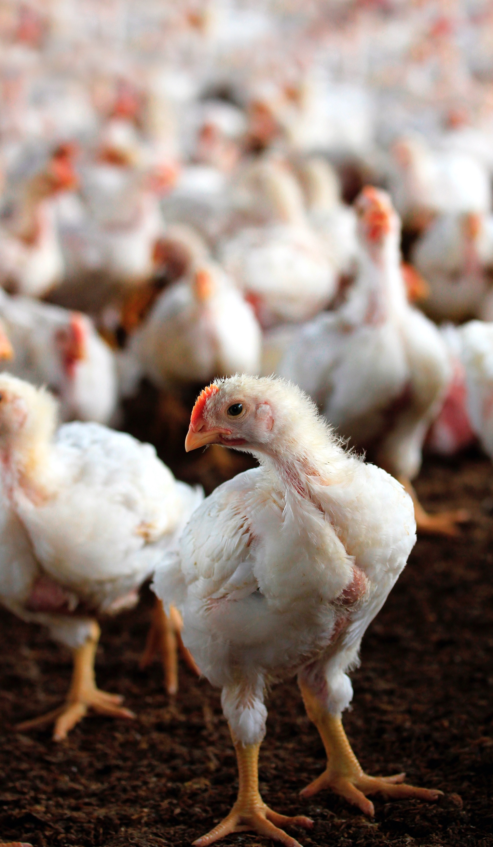
Poultry Mortality
Mortality - the term used for birds that die prior to processing. What is done with these deceased birds is very important for biosecurity, environmental, and financial reasons.
There are multiple ways to dispose of poultry mortality:
Burial - banned in many states
Incineration - costly, raises air quality concerns
Rendering – decreasing number of renderers, so they can be difficult to find
And then there is also composting…

Slide 10
Composting Poultry Mortality
Composting – the biological decomposition and stabilization of organic matter under controlled conditions. Microorganisms such as bacteria and fungi use organic waste (i.e. poultry mortality) as an energy source and the waste is transformed into compost.
Composting is an environmentally safe, biosecure, and efficient way of managing everyday losses if done correctly, although more labor-intensive.
Must have proper temperature, moisture, and oxygen in order to compost successfully and efficiently.
If done incorrectly, odors and flies are almost certain to be present…as well as issues with the Department of Environmental Quality!
This compost has value as a soil amendment, just like normal forms of compost (vegetable scraps, etc.)!

Slide 11
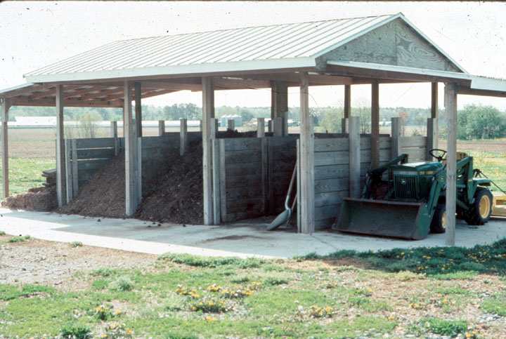
Composting Mortality Advantages
Composting poultry mortality has several on-farm advantages to consider:
Assists in averting the potential for groundwater pollution that, in the past, was associated with burial or disposal pit use.
Avoids high fuel costs and potential air pollution associated with incineration.
Prevents potential disease spread that can occur if poultry carcasses are moved off the farm.

Slide 12
What about Global Warming & the Poultry Industry?
Explore these resources!

Slide 13
Poultry Science Curriculum References
Jessica Fife, UGA Dept. of Poultry Science Outreach Coordinator, UGA Dept. of Agricultural Leadership, Education, & Communication MAEE Candidate
Barry Croom, UGA Dept. of Agricultural Leadership, Education, & Communication Professor
Ashley Yopp, UGA Dept. of Agricultural Leadership, Education, & Communication Assistant Professor
Georgia Agriculture Education
Andrew Benson, UGA Dept. of Poultry Science Assistant Professor
Brian Jordan, UGA Dept. of Poultry Science Assistant Professor, UGA College of Veterinary Medicine Assistant Professor
University of Arkansas Bumpers College of Poultry Science – Poultry Science Dual Curriculum Course
Julia Gaskin, UGA Dept. of Crop and Soil Sciences Sr. Public Service Associate
Glendon Harris, UGA Dept. of Crop and Soil Sciences Professor & Extension Agronomist
Brian Kiepper, UGA Dept. of Poultry Science Associate Professor
Claudia Dunkley, UGA Dept. of Poultry Science Public Service Associate
Casey Ritz, UGA Dept. of Poultry Science Professor
USPOULTRY & USPOULTRY Poultry Science Curriculum
Tom Tabler, Mississippi State University Department of Poultry Science Extension Professor
Jacquie Jacob, University of Kentucky
Jeanna Wilson, UGA Dept. of Poultry Science Professor
Kelly Sweeney, UGA Dept. of Poultry Science Ph.D Candidate
Merck Veterinary Manual
University of Maryland Extension
Poultry Hub
Brian Fairchild, University of Georgia Department of Poultry Science Professor
Centers for Disease Control
National FFA Organization

